Slide 1

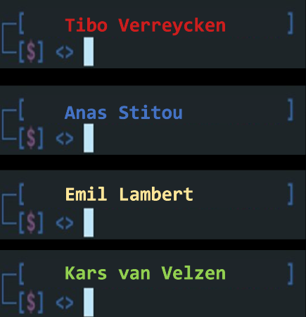
The Never{ Nestifier}

Slide 2
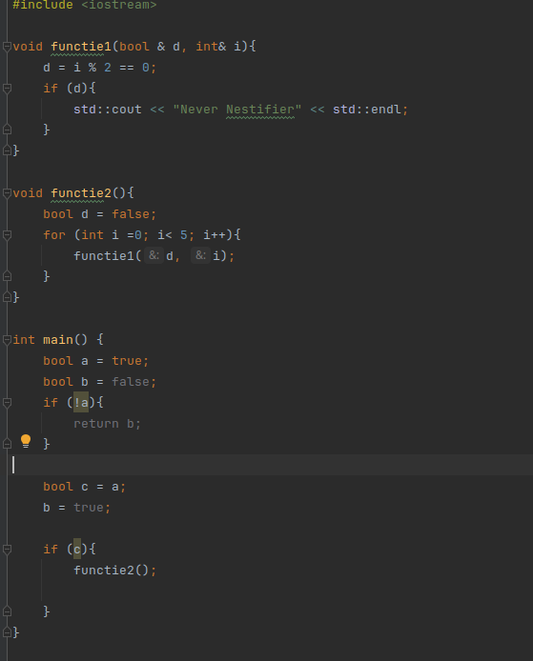
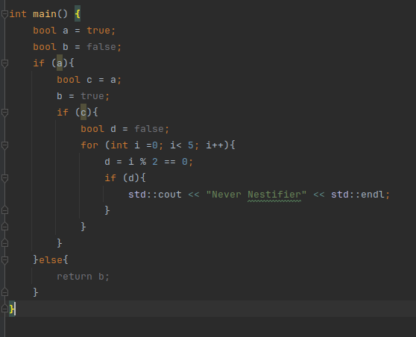
{Concept Inleiding

Slide 3




{C}onfig {
S -> {C} C -> N | C | {C} | V N -> C | e

Slide 4

GNF {Construct
CFG
CNF
GNF

Slide 5
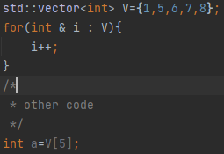
Tokenisation}
D
F{
C
}
C
D
Vector of token pairs:
{(D, vector<int> V={1,5,6,7,8}), (F, for(int i & i: V)), ({, {), (C, i++), (}, }), (C, other code), (D, int a=V[5])}
DF{C}CD

Slide 6
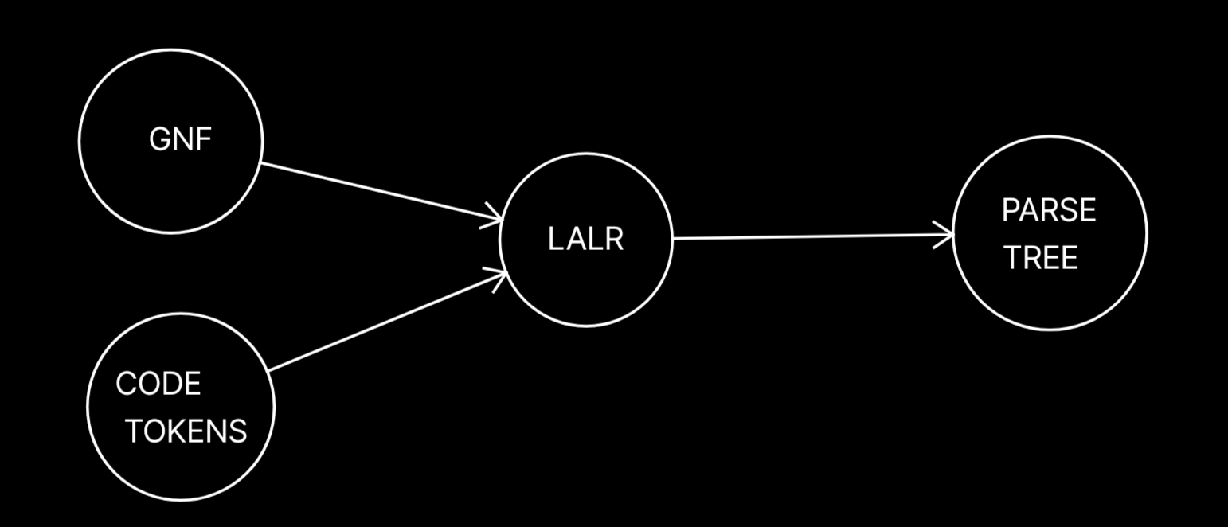
{LALR} Parser

Slide 7
Parallel {Threading

Slide 8

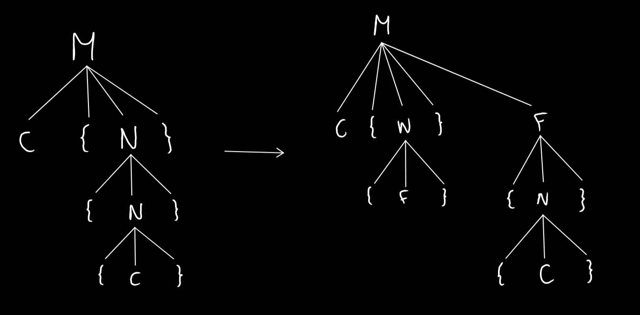
Code Gen & Parse Trees}

Slide 9
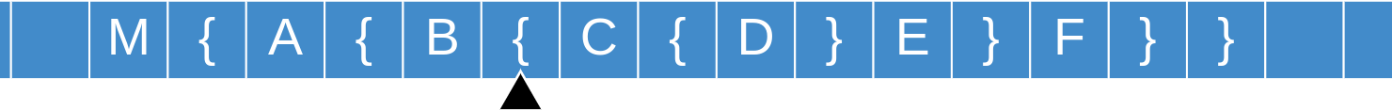




{Turing Machine}
}
Proof of concept: https://turingmachinesimulator.com/shared/uxbjvlzebp
Input: M{A{B{C{D}E}F}}

Slide 10
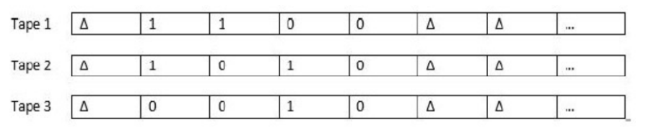

Slide 11
The Never{ Nestifier}

Slide 12

Tibo Verreycken
Anas Stitou
Emil Lambert
Kars van Velzen

